Slide 1
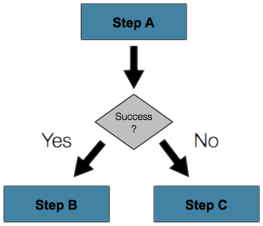
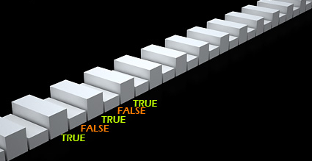
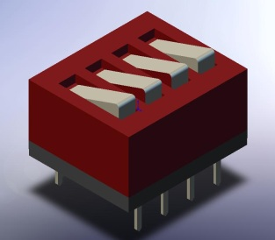

Conditional Statements
Implementing Control Logic in JavaScript
Doncho Minkov
Senior Technical Trainer
http://minkov.it
Telerik Software Academy
http://academy.telerik.com

Slide 2


Table of Contents
The if Statement
The if-else Statement
Nested if Statements
The switch-case Statement

Slide 3

if and if-else
Implementing Conditional Logic

Slide 4
The if Statement
The most simple conditional statement
Enables you to test for a condition
Branch to different parts of the code depending on the result
The simplest form of an if statement:
if (condition)
{
statements;
}

Slide 5

Condition and Statement
The condition can be:
Boolean variable
Boolean logical expression
Comparison expression
Integer, object, function… everything
The condition can be of any type
The statement can be:
Single statement ending with a semicolon
Block enclosed in braces

Slide 6
How It Works?
condition
false
true
statement
The condition is evaluated
If it is true, the statement is executed
If it is false, the statement is skipped

Slide 7
The if Statement – Example
var bigger = parseInt(document.
getElementById("first-tb").value);
var smaller = parseInt(document.
getElementById("second-tb").value);
if (smaller> bigger)
{
bigger = smaller;
}
console.log("The greater number is: " + bigger);
}

Slide 8

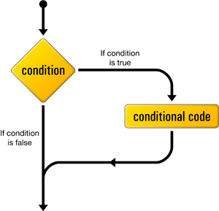
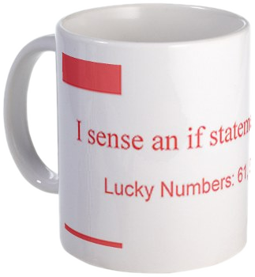
The if Statement
Live Demo

Slide 9
The if-else Statement
More complex and useful conditional statement
Executes one branch if the condition is true, and another if it is false
The simplest form of an if-else statement:
if (expression)
{
statement1;
}
else
{
statement2;
}

Slide 10
How It Works ?
condition
false
second
statement
true
first
statement
The condition is evaluated
If it is true, the first statement is executed
If it is false, the second statement is executed

Slide 11
if-else Statement – Example
Checking a number if it is odd or even
var s = document.getElementById("number-tb").value;
var number = parseInt(s);
if (number % 2 == 0)
{
console.log("This number is even.");
}
else
{
console.log("This number is odd.");
}

Slide 12
The if-else Statement
Live Demo

Slide 13
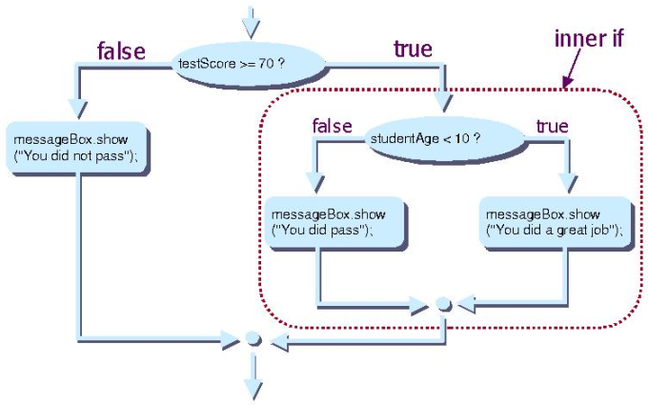
Nested if Statements
Creating More Complex Logic

Slide 14
Nested if Statements
if and if-else statements can be nested, i.e. used inside another if or else statement
Every else corresponds to its closest preceding if
if (expression)
{
if (expression)
{
statement;
}
else
{
statement;
}
}
else
statement;

Slide 15
Nested if – Good Practices
Always use { … } blocks to avoid ambiguity
Even when a single statement follows
Avoid using more than three levels of nested if statements
Put the case you normally expect to process first, then write the unusual cases
Arrange the code to make it more readable

Slide 16
Nested if Statements – Example
if (first == second)
{
console.log(
"These two numbers are equal.");
}
else
{
if (first > second)
{
console.log(
"The first number is bigger.");
}
else
{
console.log("The second is bigger.");
}
}

Slide 17
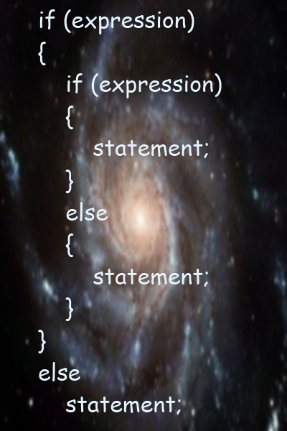
Nested if Statements
Live Demo

Slide 18
Multiple if-else-if-else-…
Sometimes we need to use another if-construction in the else block
Thus else if can be used:
var ch = 'X';
if (ch == 'A' || ch == 'a')
{
console.log("Vowel [ei]");
}
else if (ch == 'E' || ch == 'e')
{
console.log("Vowel [i:]");
}
else if …
else …

Slide 19
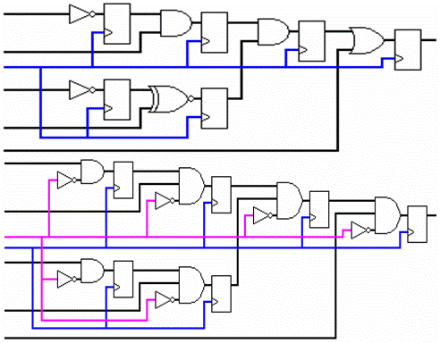
Multiple if-else Statements
Live Demo

Slide 20

switch-case
Making Several Comparisons at Once

Slide 21
The switch-case Statement
Selects for execution a statement from a list depending on the value of the switch expression
switch (day)
{
case 1: console.log("Monday"); break;
case 2: console.log("Tuesday"); break;
case 3: console.log("Wednesday"); break;
case 4: console.log("Thursday"); break;
case 5: console.log("Friday"); break;
case 6: console.log("Saturday"); break;
case 7: console.log("Sunday"); break;
default: console.log("Error!"); break;
}

Slide 22
How switch-case Works?
The expression is evaluated
When one of the constants specified in a case label is equal to the expression
The statement that corresponds to that case is executed
If no case is equal to the expression
If there is default case, it is executed
Otherwise the control is transferred to the end point of the switch statement

Slide 23

The switch-case Statement
Live Demo

Slide 24

False-like conditions
Strange behavior

Slide 25

False-like conditions
These values are always false
false
0 (zero)
"" (empty string)
null
undefined
NaN
All other values are true
Info: http://www.sitepoint.com/javascript-truthy-falsy/

Slide 26

False-like Conditions
Live Demo

Slide 27
Summary
Comparison and logical operators are used to compose logical conditions
The conditional statements if and if-else provide conditional execution of blocks of code
Constantly used in computer programming
Conditional statements can be nested
The switch statement easily and elegantly checks an expression for a sequence of values

Slide 28



Conditional Statements
http://academy.telerik.com

Slide 29
Exercises
Write an if statement that examines two integer variables and exchanges their values if the first one is greater than the second one.
Write a script that shows the sign (+ or -) of the product of three real numbers without calculating it. Use a sequence of if statements.
Write a script that finds the biggest of three integers using nested if statements.
Sort 3 real values in descending order using nested if statements.

Slide 30
Exercises (2)
Write script that asks for a digit and depending on the input shows the name of that digit (in English) using a switch statement.
Write a script that enters the coefficients a, b and c of a quadratic equation
a*x² + b*x + c = 0
and calculates and prints its real roots. Note that quadratic equations may have 0, 1 or 2 real roots.
Write a script that finds the greatest of given 5 variables.

Slide 31
Exercises (4)
Write a script that converts a number in the range [0...999] to a text corresponding to its English pronunciation. Examples:
0 → "Zero"
273 → "Two hundred seventy three"
400 → "Four hundred"
501 → "Five hundred and one"
711 → "Seven hundred and eleven"

